Slide 1
One Axis Drill Project Progress
11.06.2023

Slide 2
What Was to be achieved:
✅ Mbaire and Renox- make DC motor and stepper motor run concurrently for feed during drilling and do ANOVA analysis
✅ Katchiets - add a 5V to 3.3V regulator for stability and run simulation
✅ Morris and Allan- finish on simulink modelling of DC motor and whole mechanical assembly.

Slide 3
What Has Been Achieved
✅ Allan and Morris - finished the whole mechanical design, including addition of drill, did motion study and simulation in SOLIDWORKS, designed DC motor in Simulink
✅ Mbaire and Renox- successfully achieved simultaneous control of DC and stepper motor for drilling operationANOVA analysis, which could only be done after we are able to drill successfully is yet to be completed, shall be sent by Monday
✅ Katchiets and Steve- confirmed on the appropriate power circuit for our pcb design for sensors and actuators

Slide 4
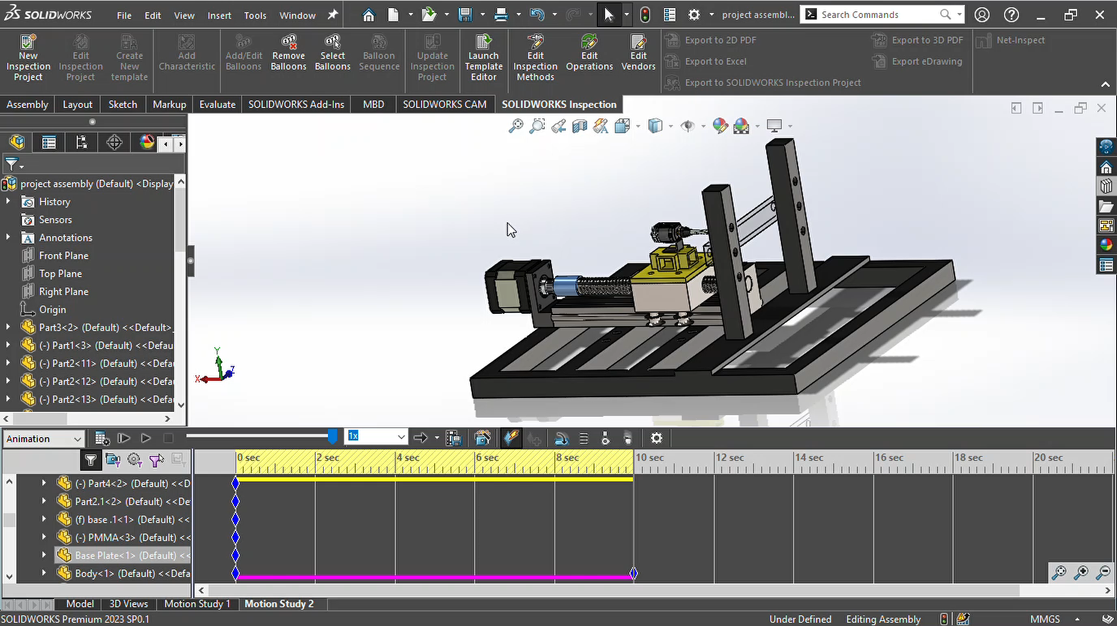
Mechanical design, addition of drill, motion study, Simulink modelling of DC Motor

Slide 5
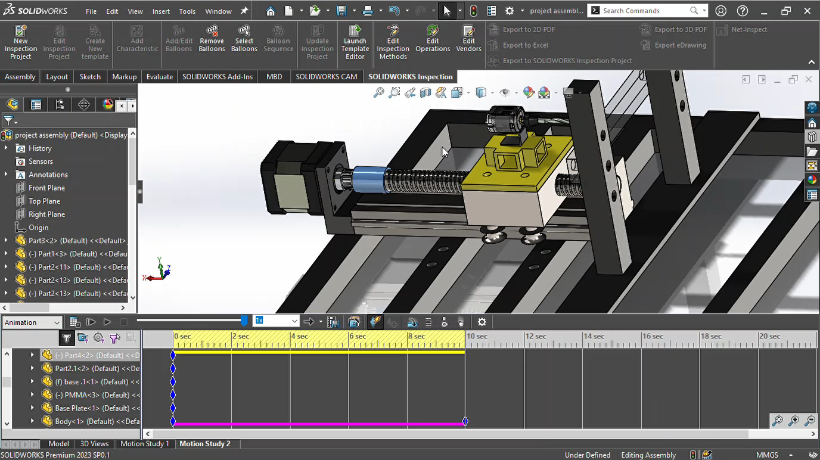

Slide 6
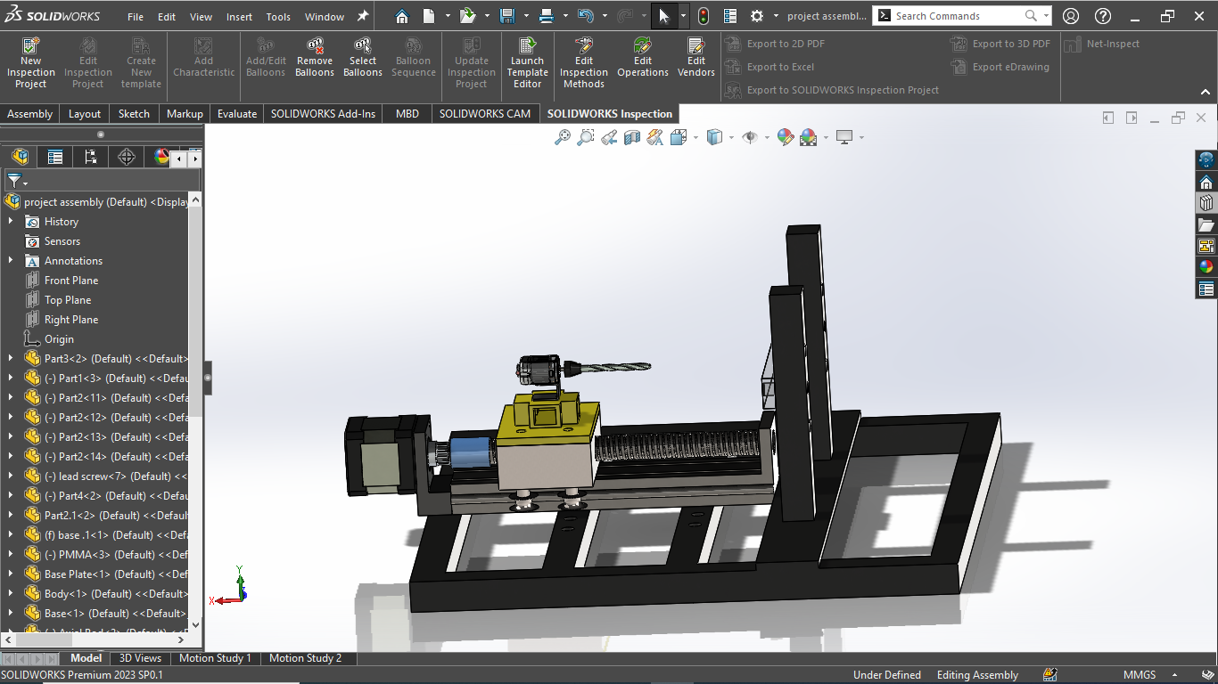
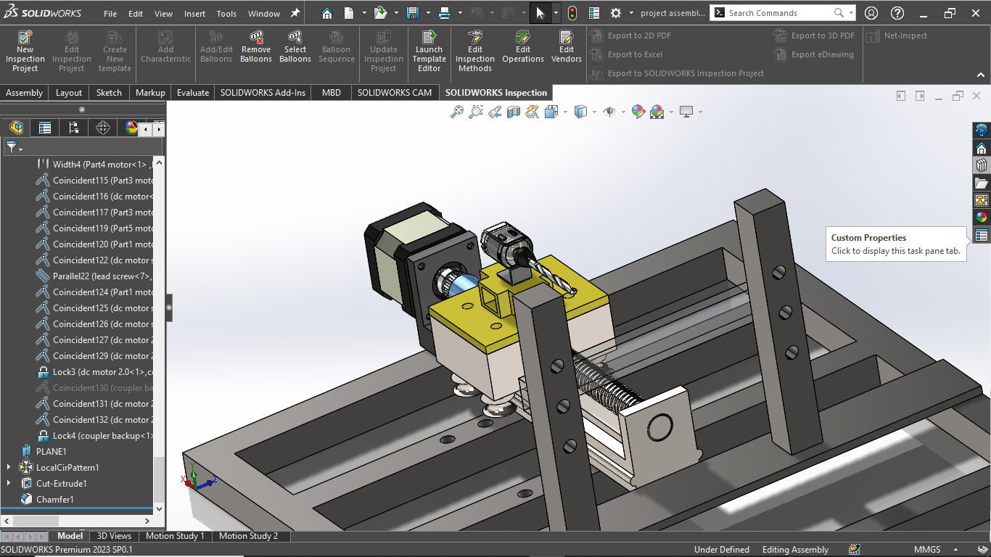

Slide 7
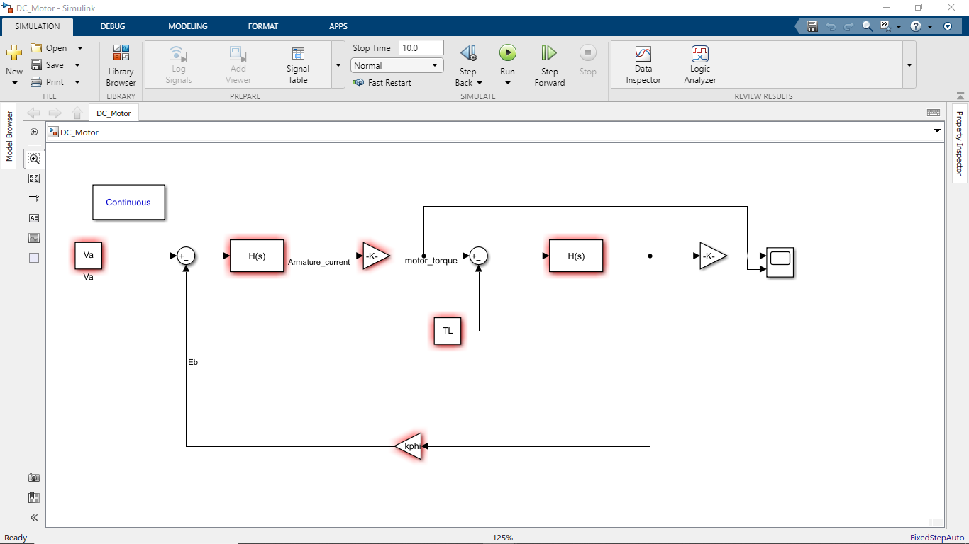
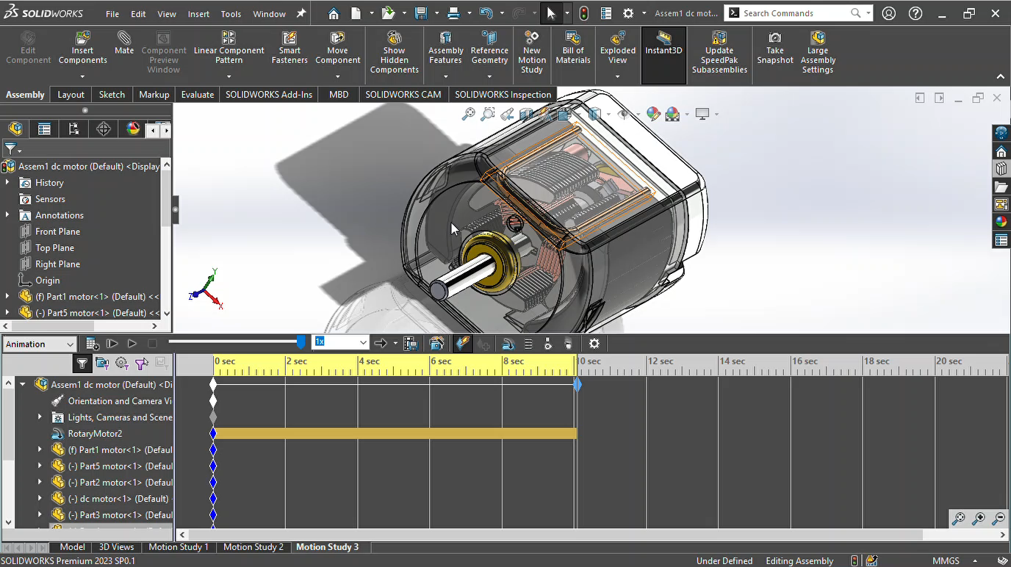
DC Motor modelled in SolidWorks and MATLAB Simulink

Slide 8
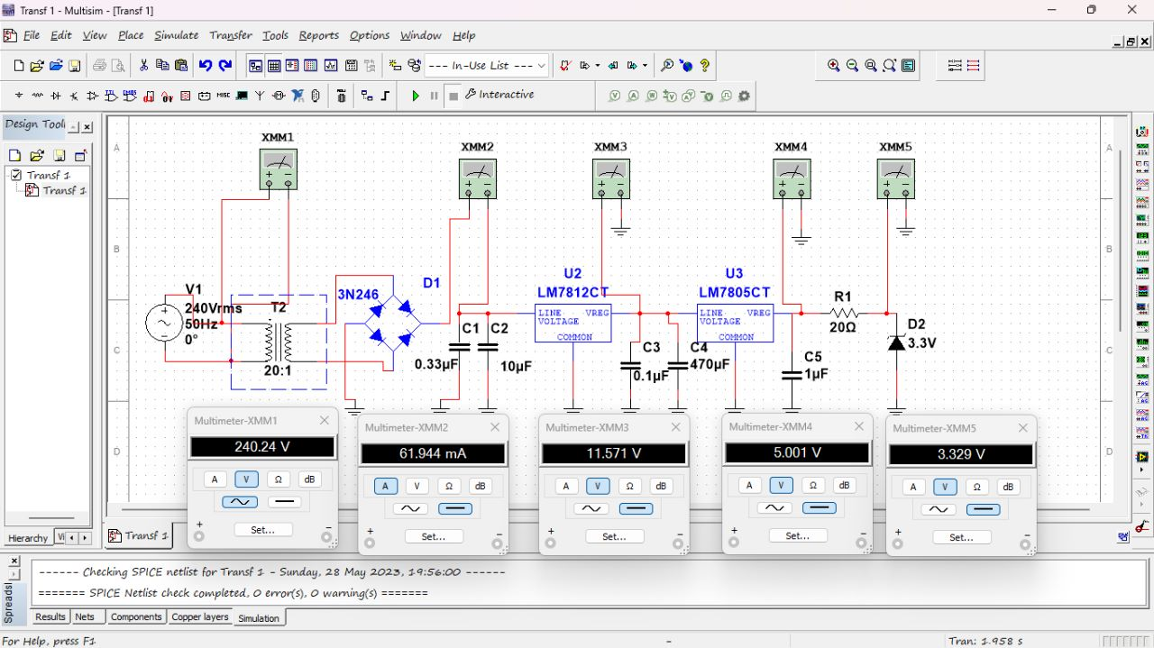
Power Supply Circuit Verification

Slide 9
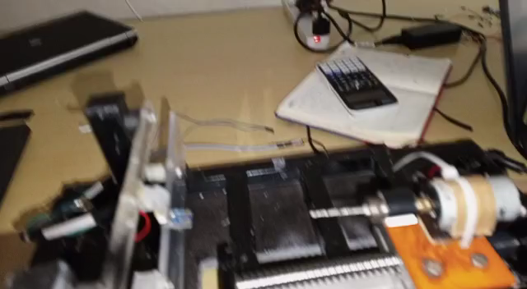
Make DC motor and stepper motor run concurrently for feed during drilling
At high DC motor speeds, the drill gets stuck in PMMA and stops rotating, melting of PMMA can be noticed

Slide 10
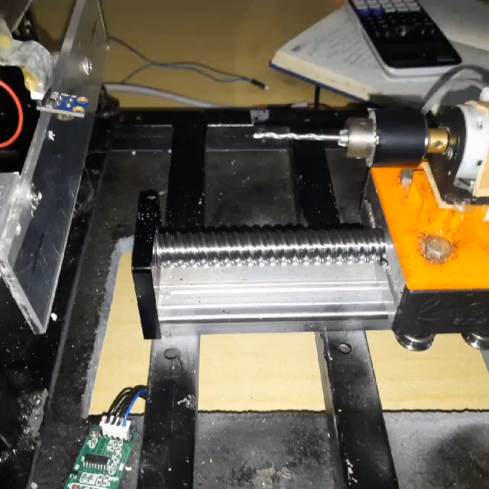
Reduced linear feed speed and dc motor rotary speeds for drilling process
Melting of PMMA can be noticed, ANOVA analysis required to determine appropriate feed and drill speeds

Slide 11
What has not been achieved yet from past week….
✅ANOVA
✅ Simulating DC motor working in Matlab

Slide 12
What is to be met this week….
✅ Mbaire and Renox- ANOVA- to be completed by Monday Simulating working system in Proteus including the sensors and actuators Integrating code to run actuators and read from sensors
✅Steve - interfacing TFT screen with Arduino
✅ Katchiets - power circuit(5V-3.3V test with zener and regulator) to be presented on Monday
✅ Morris and Allan- importing DC motor and entire mechanical project in MATLAB and simulate as it is expected to work physically

